Slide 1
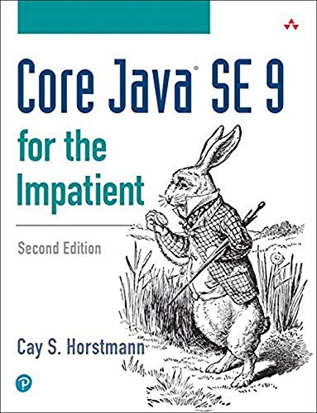
Object-Oriented Programming and Data Abstraction Lesson 1: Collections
Section 1.8
Chapter 7
Notes:
Replace this with your course title and your name/contact details.

Slide 2
Arrays

Slide 3
Arrays of Objects
Since Strings are objects, we know that arrays can contain objects.
InventoryItem[] inventory = new InventoryItem[5];
The inventory variable holds the address
of an InventoryItem array.
Address
inventory[0]
null
inventory[1]
null
inventory[2]
null
inventory[3]
null
inventory[4]
null

Slide 4
Arrays of Objects
Each element needs to be initialized.
for (int i = 0; i < inventory.length; i++)
inventory[i] = new InventoryItem();
description:
units:
The inventory variable holds the address
of an InventoryItem array.
""
0
description:
units:
""
Address
0
description:
units:
inventory[0]
Address
""
0
inventory[1]
Address
description:
units:
""
inventory[2]
Address
0
inventory[3]
Address
description:
units:
""
inventory[4]
Address
0
Example: http://jackmyers.info/oopda/src/Lesson-01/objectArray/

Slide 5
What if you don't initialize the full Array?
You entered the following:
Item 1
Description: Eggs
Units: 3
Item 2
Description: Peppers
Units: 3
Item 3
Exception in thread "main" java.lang.NullPointerException
at uninitializedObjectArray.UninitializedObjectArray.main( UninitializedObjectArray.java:27)
Example: http://jackmyers.info/oopda/src/Lesson-01/uninitializedObjectArray/

Slide 6
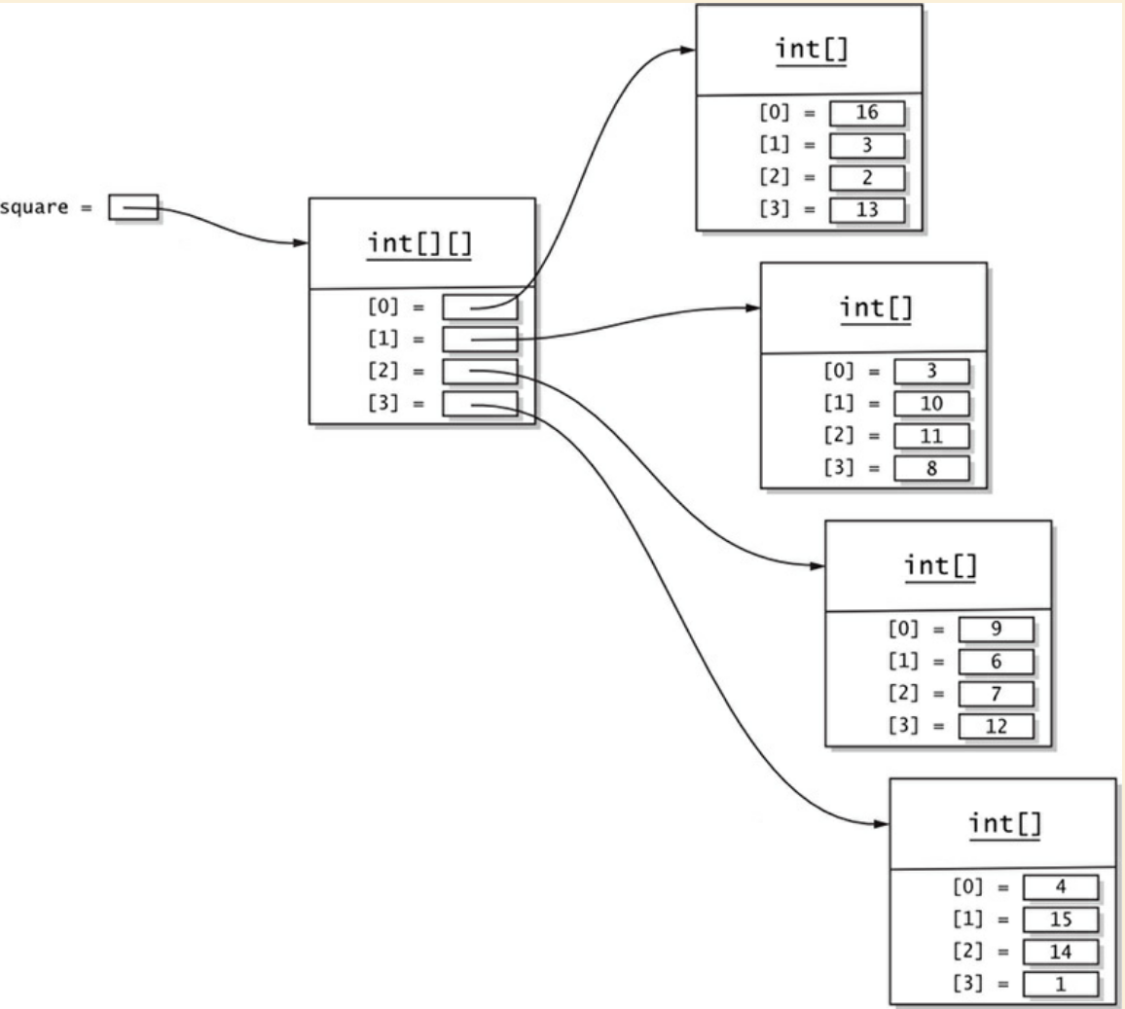
Multi-Dimensional Arrays
Java does not have true multidimensional arrays. They are implemented as arrays of arrays.
For example, here is how you declare and implement a two-dimensional array of integers:
int[][] square = {
{ 16, 3, 2, 13 },
{ 5, 10, 11, 8 },
{ 9, 6, 7, 12 },
{ 4, 15, 14, 1}
};
Technically, this is a one-dimensional array of int[] arrays.

Slide 7
Beyond Arrays of Objects
While it is good to be able to use arrays to store objects, this is limiting.
Arrays need to be declared with a size, so that memory can be allocated to store an address of each row.
But often we don't know how many rows we will have…
… and building super large arrays to give us enough capacity will consume memory needlessly
COLLECTIONS are the answer
The inventory variable holds the address
of an InventoryItem array.
Address
inventory[0]
Address
inventory[1]
Address
inventory[2]
Address
inventory[3]
Address
inventory[4]
Address

Slide 8
Part of the collection framework
Collection
An object that can hold one or more objects
Set
Unordered collection of unique objects
List
An ordered collection of objects
Map
Like a collection
Its objects are key-value pairs
Legend
interface
class

Slide 9
There are LOTS of Collections and Maps
Collection
Set
AbstractSet, ConcurrentSkipListSet, CopyOnWriteArraySet, EnumSet, HashSet, JobStateReasons, LinkedHashSet, TreeSet
List
AbstractList, AbstractSequentialList, ArrayList, AttributeList, CopyOnWriteArrayList, LinkedList, RoleList, RoleUnresolvedList, Stack, Vector
Map
AbstractMap, Attributes, AuthProvider, ConcurrentHashMap, ConcurrentSkipListMap, EnumMap, HashMap, Hashtable, IdentityHashMap, LinkedHashMap, PrinterStateReasons, Properties, Provider, RenderingHints, SimpleBindings, TabularDataSupport, TreeMap, UIDefaults, WeakHashMap

Slide 10
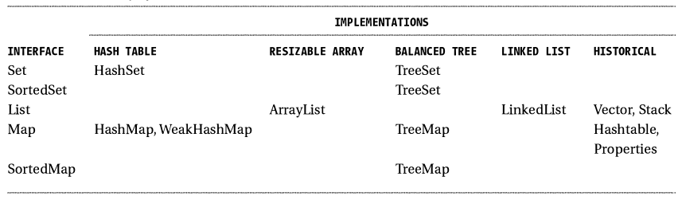
Some Implementations of Collections
INTERFACES
Set the rules of behavior
IMPLEMENTATIONS
Describe how collections are managed in memory

Slide 11
Modifier and Type | Method and Description
boolean | add(E e)Ensures that this collection contains the specified element (optional operation).
boolean | addAll(Collection<? extends E> c)Adds all of the elements in the specified collection to this collection (optional operation).
void | clear()Removes all of the elements from this collection (optional operation).
boolean | contains(Object o)Returns true if this collection contains the specified element.
boolean | containsAll(Collection<?> c)Returns true if this collection contains all of the elements in the specified collection.
boolean | equals(Object o)Compares the specified object with this collection for equality.
int | hashCode()Returns the hash code value for this collection.
boolean | isEmpty()Returns true if this collection contains no elements.
Iterator<E> | iterator()Returns an iterator over the elements in this collection.
default Stream<E> | parallelStream()Returns a possibly parallel Stream with this collection as its source.
boolean | remove(Object o)Removes a single instance of the specified element from this collection, if it is present (optional operation).
boolean | removeAll(Collection<?> c)Removes all of this collection's elements that are also contained in the specified collection (optional operation).
default boolean | removeIf(Predicate<? super E> filter)Removes all of the elements of this collection that satisfy the given predicate.
boolean | retainAll(Collection<?> c)Retains only the elements in this collection that are contained in the specified collection (optional operation).
int | size()Returns the number of elements in this collection.
default Spliterator<E> | spliterator()Creates a Spliterator over the elements in this collection.
default Stream<E> | stream()Returns a sequential Stream with this collection as its source.
Object[] | toArray()Returns an array containing all of the elements in this collection.
All Collections must implement all of these behaviors (methods)

Slide 12
ArrayLists
Collection
List
ArrayList
LinkedList
Vector
Set
HashSet
LinkedHashSet
TreeSet
Legend
interface
class

Slide 13
Lists (Exceprts from the API)
public interface List<E> extends Collection<E>
An ordered collection (also known as a sequence). The user of this interface has precise control over where in the list each element is inserted. The user can access elements by their integer index (position in the list), and search for elements in the list.
Unlike sets, lists typically allow duplicate elements. More formally, lists typically allow pairs of elements e1 and e2 such that e1.equals(e2), and they typically allow multiple null elements if they allow null elements at all.
The List interface provides four methods for positional (indexed) access to list elements. Lists (like Java arrays) are zero based. Note that these operations may execute in time proportional to the index value for some implementations (the LinkedList class, for example). Thus, iterating over the elements in a list is typically preferable to indexing through it if the caller does not know the implementation.
The List interface provides a special iterator, called a ListIterator, that allows element insertion and replacement, and bidirectional access in addition to the normal operations that the Iterator interface provides. A method is provided to obtain a list iterator that starts at a specified position in the list.
This interface is a member of the Java Collections Framework.

Slide 14
ListIterator
Return | Method and Description
void | add(E e) Inserts the specified element into the list (optional operation).
boolean | hasNext() Returns true if this list iterator has more elements when traversing the list in the forward direction.
boolean | hasPrevious() Returns true if this list iterator has more elements when traversing the list in the reverse direction.
E | next() Returns the next element in the list and advances the cursor position.
int | nextIndex() Returns the index of the element that would be returned by a subsequent call to next().
E | previous() Returns the previous element in the list and moves the cursor position backwards.
int | previousIndex() Returns the index of the element that would be returned by a subsequent call to previous().
void | remove() Removes from the list the last element that was returned by next() or previous() (optional operation).
void | set(E e) Replaces the last element returned by next() or previous() with the specified element (optional operation).

Slide 15
Arrays vs. ArrayLists: Sizing
When you construct an array, you need to know its length which can never change.
A remedy is to use the ArrayList class in the java.util package. An ArrayList object manages an array internally.
Arrays are of fixed size, when the ArrayList becomes too large for its Array or becomes too small for its Array (thru deletions), another internal array is automatically created, and the elements are moved into it.
These processes are invisible to the programmer using the ArrayList.
Each ArrayList instance has a capacity -- the size of the array used to store the elements in the list. It is always at least as large as the list size. Default capacity is 10 items.
As elements are added to an ArrayList, its capacity grows automatically. Details of the growth policy aren't specified beyond the fact that adding an element has constant amortized time cost.
But you can increase an ArrayList's capacity before adding a large number of elements using the ensureCapacity operation which may reduce the amount of incremental reallocation.
To designate a different capacity, use a parameterized constructor:
ArrayList<Person> list = new ArrayList<Person>(100);

Slide 16
Arrays vs. ArrayLists: Generics (1)
The ArrayList class is a generic class — a class with a type parameter.
You often need to implement classes and methods that work with multiple types. For example, an ArrayList<T> stores elements of an arbitrary class T.
We say that the ArrayList class is generic, and T is a type parameter.
Howeer no primitive types, only subclasses of Object
private ArrayList<String> files; // Declaration
files = new ArrayList<String>(); // Initialization
files = new ArrayList<>(); // Initialization Java 7+ // String inferred from declaration
What kind of ArrayList would we make if e did not use diamond notation?
diamond notation

Slide 17
Arrays vs. ArrayLists: Generics (2)
Generics enable types (e.g., classes and interfaces) to be parameters.
Advantages of Generics
Stronger type checks at compile time. A Java compiler applies strong type checking to generic code and issues errors if the code violates type safety. Fixing compile-time errors is easier than fixing runtime errors, which can be difficult to find.
Enabling programmers to implement generic algorithms. By using generics, programmers can implement generic algorithms that work on collections of different types, can be customized, and are type safe and easier to read.
Elimination of casts. The following code snippet without generics requires casting:
ArrayList list = new ArrayList(); list.add("hello"); String s = (String) list.get(0); When re-written to use generics, the code does not require casting: ArrayList<String> list = new ArrayList<String>(); list.add("hello"); String s = list.get(0); // no cast

Slide 18

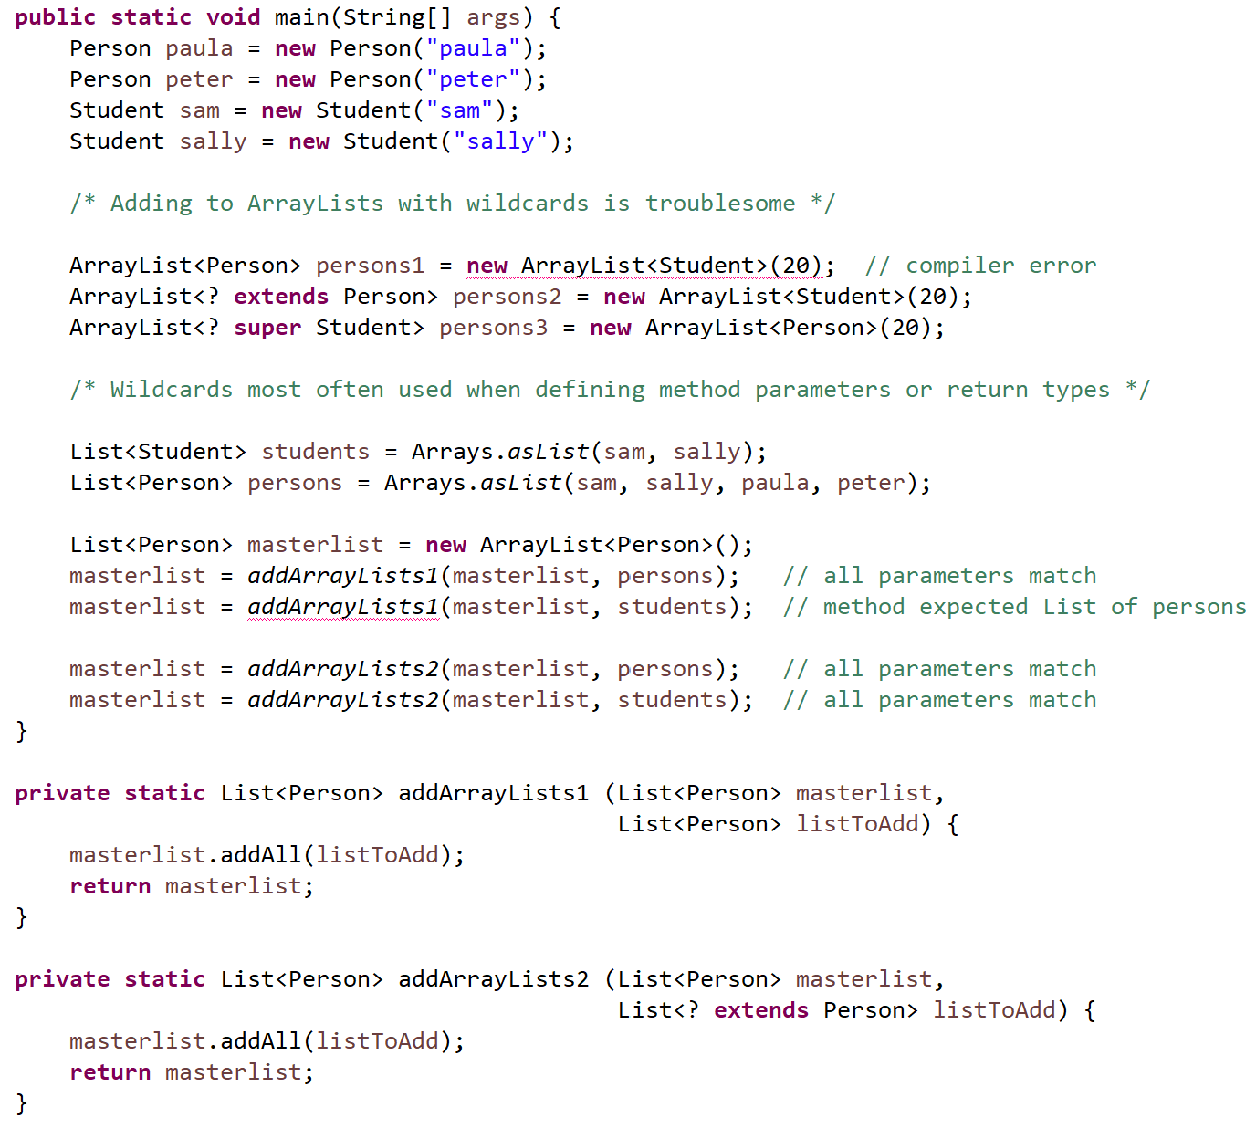
Generics and Wildcards
http://jackmyers.info/oopda/src/Lesson-01/AL_GenericInheritance
compilation errors
In Java, you use wildcards to specify how method parameter and return types should be allowed to vary. This mechanism is sometimes called use-site variance.
The question mark (?) is known as the wildcard in generic programming and represents an unknown type.
The wildcard can be used in a variety of situations e.g., the type of a parameter, field, or local variable or as a return type.

Slide 19
Accessing ArrayList Items
To access items in an ArrayList, use the get method
nameList.get(1);
In this statement "1" is the index of the item to get.
Examples: http://jackmyers.info/oopda/src/Lesson-01/ NongenericArrayList.java http://jackmyers.info/oopda/src/Lesson-01/ GenericArrayList.java
public class ArrayListDemo1
{
public static void main(String[] args)
{
// Create an ArrayList to hold some names.
ArrayList nameList = new ArrayList();
// Add some names to the ArrayList.
nameList.add("James");
nameList.add("Catherine");
nameList.add("Bill");
// Display the size of the ArrayList.
System.out.println("The ArrayList has " +
nameList.size() + " objects stored in it.");
// Now display the items in nameList.
for (int i= 0; i < nameList.size(); i++)
System.out.println(nameList.get(i));
}
}

Slide 20
Using an ArrayList (1)
The ArrayList class's toString method returns a string representing all items in the ArrayList
System.out.println(nameList);
This statement yields :
[ James, Catherine ]
The ArrayList class's remove method removes designated item from the ArrayList
nameList.remove(1);
This statement removes the second item.

Slide 21
Using an ArrayList (2)
The ArrayList class's add method with one argument adds new items to the end of the ArrayList
To insert items at a location of choice, use the add method with two arguments:
nameList.add(1, "Mary");
This statement inserts the String "Mary" at index 1
To replace an existing item, use the set method:
nameList.set(1, "Becky");
This statement replaces “Mary” with “Becky”

Slide 22
Many ArrayList Methods (1)
Method | Description
add(object) | Appends the specified object to the end of this list.
add(index, object) | Inserts the specified object at the specified position in this list.
addAll(collection) | Appends all of the elements in the specified collection to the end of this list, in the order that they are returned by the specified collection's Iterator.
addAll(int index, collection) | Inserts all of the elements in the specified collection into this list, starting at the specified position.
clear() | Removes all of the elements from this list.
contains(object) | Returns true if this list contains the specified element.
get(int index) | Returns the element at the specified position in this list.
indexOf(object) | Returns the index of the first occurrence of the specified element in this list, or -1 if this list does not contain the element.
isEmpty() | Returns true if this list contains no elements.
iterator() | Returns an iterator over the elements in this list in proper sequence.
lastIndexOf(object) | Returns the index of the last occurrence of the specified element in this list, or -1 if this list does not contain the element.

Slide 23
Many ArrayList Methods (2)
Method | Description
listIterator() | Returns a list iterator over the elements in this list (in proper sequence).
listIterator(int index) | Returns a list iterator over the elements in this list (in proper sequence), starting at the specified position in the list.
remove(int index) | Removes the element at the specified position in this list.
remove(object) | Removes the first occurrence of the specified element from this list, if it is present.
removeRange (int fromIndex, int toIndex) | Removes from this list all of the elements whose index is between fromIndex, inclusive, and toIndex, exclusive.
set(int index, object) | Replaces the element at the specified position in this list with the specified element.
size() | Returns the number of elements in this list.
subList(int fromIndex, int toIndex) | Returns a view of the portion of this list between the specified fromIndex, inclusive, and toIndex, exclusive.
toArray() | Returns an array containing all of the elements in this list in proper sequence (from first to last element).

Slide 24
How an ArrayList works (1)
public class Notebook {
public ArrayList<String> notes;
}
public class NotebookTest {
public static void main(String[] args) {
Notebook myBook = new Notebook();
// myBook.notes has not been // initialized, it is null
myBook.notes = new ArrayList<String>();
myBook.notes.add("Buy bread");
myBook.notes.add("Recharge phone"); // possible as notes is public
}
}
myBook:Notebook
notes
ArrayList<String>
0 1
:String
:String
"Buy bread"
"Recharge phone"

Slide 25
How an ArrayList works (2)
Notebook myBook = new Notebook();
myBook.notes = new ArrayList<String>();
for (String note : myBook.notes) {
System.out.println(note);
}
System.out.printf("There are %d notes in the notebook.\n", myBook.notes.size());
myBook:Notebook
notes
ArrayList<String>
0 1
:String
:String
Features of ArrayList
It can increase capacity as required
It maintains a count of how many items it is storing. Retrievable through size() method.
It maintains the order of items inserted into it.
"Buy bread"
"Recharge phone"

Slide 26
Looping through a collection
notes.forEach(n -> System.out.println(n);
for (String note : notes) {
System.out.println(note);
}
String searchString = "bread";
boolean found = false;
int i = 0;
while (i < notes.size() && !found) {
String note = notes.get(i);
if (note.contains(searchString))
found = true; // ok to exit loop
else i++;
}
if (found)
System.out.printf("%s found at position %d.\n", searchString, i);
else
System.out.printf("%s not found.\n", searchString);
Three ways to loop through a collection
Using lambdas
For-each
While
The first two are simpler when you have to go through the entire collection.
While is better when you need to exit early

Slide 27
Iterating Over a Collection
An iterator object can also be used to iterate through a collection.
Iterators needed if we want to delete an element of a Collection while looping thru it.
An Iterator is a generic type, and thus it needs to be parameterized (e.g., <String>)
Examples on website:
Notebook
NotebookIterator
// Test of loop with Iterator
ListIterator<String> it = myBook.notes.listIterator();
while (it.hasNext()) {
System.out.println(it.next());
}
hasNext()
returns true if the Iterator has more elements
next()
Returns the next element in the iteration.
Let's examine NotebookIterator.

Slide 28
Using subLists
ArrayList<String> myList
List subset = myList.subList(1, 3); // end position is exclusive
subset.set(0, "Seven"); // modifying subset changes ArrayList ArrayList<String> myList
subset.clear(); // removes all elements from list ArrayList<String> myList
One
Two
Three
Four
Five
Six
Two
Three
One
Seven
Three
Four
Five
Six
One
Four
Five
Six

Slide 29
LinkedLists
Collection
List
ArrayList
LinkedList
Vector
Set
HashSet
LinkedHashSet
TreeSet
Legend
interface
class

Slide 30
How an ArrayList works
myBook:Notebook
notes
ArrayList<String>
0 1 2 3 4
:String
:String
:String
"Buy bread"
"Call Aunt Sue"
"Sew pocket"
:String
:String
"Unclog sink"
"Pay Visa bill"

Slide 31
How a LinkedList Works
A LinkedList is a doubly linked list.
myBook:Notebook
notes
LinkedList<String>
head tail
:String
:String
:String
"Buy bread"
"Call Aunt Sue"
"Sew pocket"
:String
:String
"Unclog sink"
"Pay Visa bill"

Slide 32
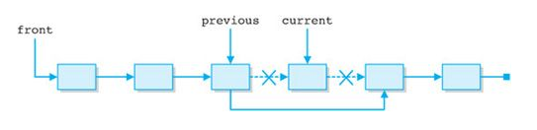
Deleting from a Linked List
Deleting from an ArrayList, requires all pointers to be shuffled
For example in a six item list, after deleting item 2
item[3] → item[2]; item[4] → item[3]; item[5] → item[4]
Deleting from an LinkedList requires only one change
Deleting the current position only requires a change to the previous item's pointer.
Inserting works similarly.

Slide 33
ArrayLists vs. LinkedLists
ArrayLists provide quick, random access to elements
As ArrayLists have random access, you can grab any element in constant time.
But adding or removing from anywhere but the end requires shifting all the latter elements over, either to make an opening or fill the gap.
Also, if you add more elements than the capacity of the underlying array, a new array (twice the size) is allocated
To avoid the high cost of resizing when you know you're going to add a lot of elements, construct the ArrayList with a higher initial capacity.
LinkedLists provides quick insertions and deletions at positions other than the end.
LinkedList allows for constant-time insertions or removals, but only sequential access of elements.
In other words, you can walk the list forwards or backwards, but grabbing an element in the middle takes time proportional to the size of the list.
No resizing costs
Use a LinkedLIst if:
The application doesn't need random access.
The application is more insertion and deletion driven and you insert or remove more than retrieve.

Slide 34
LinkedList methods compared to ArrayList methods
ArrayList Methods
add(object) | lastIndexOf(object)
add(index) | listIterator()
addAll(collection) | listIterator(int index)
addAll(int index, collection) | remove(int index)
clear() | remove(object)
contains(object) | removeRange (int fromIndex, int toIndex)
get(int index) | set(int index, object)
indexOf(object) | size()
isEmpty() | subList(int fromIndex, int toIndex)
iterator() | toArray()
Based on what we know about how LinkedLists work, which two ArrayList methods do you think would NOT apply to a LinkedList?
But, because of how it works, a LinkedList has some additional methods.
removeRange
(int fromIndex,
int toIndex)
LinkedList Methods
addFirst(object) | addLast(object)
getFirst(object) | getLast(object)
removeFirst(object) | removeLast(object)
subList(int fromIndex,
int toIndex)

Slide 35
Vectors
Collection
List
ArrayList
LinkedList
Vector
Set
HashSet
LinkedHashSet
TreeSet
Legend
interface
class

Slide 36
Vectors
Vectors are older than ArrayLists and LinkedLists.
Considered a "legacy" form of collection
Java vectors act like dynamically sized arrays

Slide 37
HashSets
Collection
List
ArrayList
LinkedList
Vector
Set
HashSet
LinkedHashSet
TreeSet
Legend
interface
class

Slide 38
Order of Elements
So far, we have seen that the order of elements is determined by its array position.
Whether using an ArrayList or a LinkedList, each element has a position that can be used to retrieve a value:
myLinkedList.get(4);
myArrayList.get(17);
Hashing means that the order — and, more specifically, the location of an item within the collection — is determined by some function of the value of the entire element or one of its key values.
In hashing, elements are stored in a hash table, with their location in the table determined by a hashing function.

Slide 39
A Primitive (and bad) Hashing Function
Amber
Suppose we had a hashing function that would store names in locations based on the first letter of the name.
Let's store a few names:
Amber, Bill, Derek, Gwen, Jack, Oswald
Our hashing function determines the storage location.
Now let's store Gary.
"Gary" would hash to the same location as "Gwen"
This is referred to as a collision.
That memory location could now store Gary and Gwen in a linked list of elements that are hashed to that bucket, making lookups in hash tables very slow.
Bill
Derek
Gwen
⬅ "Gary"
Jack
A perfect hashing algorithm would never result in a collision.
Oswald

Slide 40
Bucket : 0, Entry: null
Bucket : 1, Entry: Amber=Amber
Bucket : 2, Entry: Bill=Bill
Bucket : 3, Entry: null
Bucket : 4, Entry: Derek=Derek
Bucket : 5, Entry: null
Bucket : 6, Entry: null
Bucket : 7, Entry: Gwen=Gwen
Bucket : 8, Entry: null
Bucket : 9, Entry: null
Bucket : 10, Entry: Jack=Jack
Bucket : 11, Entry: null
Bucket : 12, Entry: null
Bucket : 13, Entry: null
Bucket : 14, Entry: null
Bucket : 15, Entry: Oswald=Oswald
Before adding Gary
Amber
Bill
Derek
Gwen
⬅ "Gary"
Bucket : 0, Entry: null
Bucket : 1, Entry: Amber=Amber
Bucket : 2, Entry: Bill=Bill
Bucket : 3, Entry: null
Bucket : 4, Entry: Derek=Derek
Bucket : 5, Entry: null
Bucket : 6, Entry: null
Bucket : 7, Entry: Gwen=Gwen -> Gary=Gary
Bucket : 8, Entry: null
Bucket : 9, Entry: null
Bucket : 10, Entry: Jack=Jack
Bucket : 11, Entry: null
Bucket : 12, Entry: null
Bucket : 13, Entry: null
Bucket : 14, Entry: null
Bucket : 15, Entry: Oswald=Oswald
After adding Gary
Jack
A perfect hashing algorithm would never result in a collision.
Oswald

Slide 41
The HashSet (1)
Hash
Set
HashSet
As it name implies, a HashSet is a collection that does not allow:
Duplicate elements (a characterstic of a Set)
Positions for its elements (a characteristic of hashing)
This class implements the Set interface and creates a collection that uses a hash table for storage.
Keys are placed into a slot (or "bucket"), based on the hash code, but even that isn't a trivial order-by-hash-code.
As much as is reasonably practical, the hashCode method defined by class Object does return distinct integers for distinct objects. (This is typically implemented by converting the internal address of the object into an integer.)

Slide 42
The HashSet (2)
A HashSet makes no guarantees as to the iteration order of the set.
It does not guarantee that the order will remain constant over time.
This class permits the null element.
The backing hash table ensures that duplicate elements are avoided as each element is stored and retrieved through its hash code.
Use a HashSet when you expect and want a unique set.
LinkedHashSets preserve the insertion order

Slide 43
An Example of a HashSet
private void processText(String value) {
// Parse the string into words using a RegExp of delimiters
String[] tokens = value.split("[\n\t\r (),.:;+]");
HashSet<String> uniqueWords = new HashSet<>();
for (String token : tokens) {
if (token.length() > 0) {
// add returns a boolean. It will return false if the // token was not added, i.e., it is a duplicate that // cannot be stored in a Set.
if (!uniqueWords.add(token.toLowerCase()))
System.out.println("Duplicate detected : " + token);
}
}
System.out.printf("\nThere are %d unique words found ", uniqueWords.size());
for (String word : uniqueWords) {
System.out.print(word + " ");
}
}

Slide 44
Results of WordAnalyzer
The New Jersey State Commission of Investigation (SCI) is an independent governmental fact-finding agency in the U.S. State of New Jersey whose mission is to identify and investigate organized crime, corruption and waste, fraud and abuse in government spending by state, municipal and school bodies. It was established in 1969 as an independent agency funded directly by the New Jersey Legislature.
No more than two of the Commission's four members may be of the same political party, and its members are appointed by the Governor of New Jersey, the President of the New Jersey Senate and the Speaker of the New Jersey General Assembly, to serve three-year terms on a staggered basis. Members and staff of the SCI are prohibited from participating in non-federal political activity in New Jersey.
The Governor, members of the Legislature, and other public officials at the federal, state, county and local level can refer matters to the Commission, as can average taxpayers. The SCI is an investigative body that operates in the fashion of an inspector general. It conducts fact-finding probes, often targeting wasteful and abusive governmental practices, and makes the results public even if no criminal prosecution is contemplated.
There are 138 unique words found waste president hearings abusive criminality no fact-finding conducts governor its party legislature beyond practices prosecutorial of abuse are refer criminal governmental on government commission these spending serve information or identify organized matters prosecution investigate not authorities...
Note that the unique words are not in any particular order

Slide 45
Tip on Using Collections Why Polymorphism is Important!
TIP: When creating any collection, it is always best to have the local variable be of the interface type, as in
Set set = new HashSet();
That way, if you later decide to change the set to a TreeSet or some other set implementation, you won't have to change any code as you'll only be using the methods of the Set interface.
John Zukowski. Java Collections

Slide 46
Advanced Collection Features
Removing and Adding Collections to Collections
removeIf (using lambda expressions)
See http://jackmyers.info/oopda/src/Lesson-01/advancedCollections/ShoppingCart.java and
removeAll(Collection<?> c) | Removes all of this collection's elements that are also contained in the specified collection (optional operation).
addAll(Collection<? extends E> c) | Adds all of the elements in the specified collection to this collection (optional operation).
retainAll(Collection<?> c) | Retains only the elements in this collection that are contained in the specified collection (optional operation).
removeIf(Predicate<? super E> filter) | Removes all of the elements of this collection that satisfy the given predicate.

Slide 47
LinkedHashSets
Collection
List
ArrayList
LinkedList
Vector
Set
HashSet
LinkedHashSet
TreeSet
Legend
interface
class

Slide 48
LinkedHashSet
public class LinkedHashSet<E>
extends HashSet<E>
implements Set<E>
This implementation differs from HashSet in that it maintains a doubly-linked list running through all of its entries. This linked list defines the iteration ordering, which is the order in which elements were inserted into the set (insertion-order).

Slide 49
Working with Sets
// Iterate through wishlist, prompt whether to order
HashSet<Book> order = new HashSet<Book>();
for (Book b : wishlist) {
System.out.print("Purchase " + b + "? (y/n) ");
if (sc.next().toLowerCase().charAt(0) == 'y') {
order.add(b);
}
}
sc.close(); // Close input scanner
wishlist.removeAll(order); // ordered items come off wish list
System.out.println("\nRevised wish list");
wishlist.forEach(b -> System.out.println("\t" + b));
System.out.println("\nRemoval of old books");
wishlist.removeIf(b -> b.getPublicationYear() < 1990);
wishlist.forEach(b -> System.out.println("\t" + b));
http://jackmyers.info/oopda/src/Lesson-02/advancedCollections/ShoppingCart.java

Slide 50
TreeSets
Collection
List
ArrayList
LinkedList
Vector
Set
HashSet
LinkedHashSet
TreeSet
Legend
interface
class

Slide 51
TreeSets
The other concrete Set implementation is the TreeSet.
The TreeSet class works exactly the same as the HashSet class with one notable exception: instead of keeping its elements unordered, a TreeSet keeps its elements ordered internally.
Not only are the elements ordered, but the tree is balanced. More specifically, it's a "red-black" tree.
Having a balanced tree guarantees a quick search time at the cost of a more time-intensive insertion (and deletion).

Slide 52
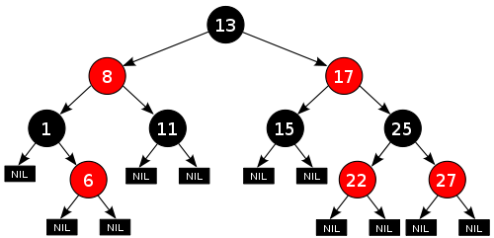
A "Red-Black" Tree
Insert a 10
Insert a 12
Every node in the tree is either black or red.
The root is always black.
If a node is red, its children must be black.
Every path from the root to a leaf (or null child) must contain the same number of black nodes.

Slide 53
TreeMaps use a compareTo() method to build the tree
For now, all you have to know is that there is a special mothod called compareTo() which helps decide where objects should be inserted.
The compareTo() method can return one of three values.
A negative number if the current object comes before the object compared to.
A positive number if the current object comes after the object compared to.
Zero if the two objects are equal.
Examples
Comparing "Della" to "Bella" returns positive 2 "Della".compareTo("Bella")
Comparing 12/1/2020 to 12/19/2020 returns negative 18 LocalDate.of(2020, 12, 1).compareTo(LocalDate.of(2020, 12, 19))
Your classes that you want to store in a TreeMap should implement their own compareTo() method.

Slide 54
Implementing your own compareTo()
public class Book implements Comparable<Book> {
@Override
public int compareTo(Book b) {
// Compare alphabetically by title, then by author
int compare = this.title.compareTo(b.getTitle());
if (compare != 0) {
// The books have different String titles
return compare;
}
else {
// Let's compare by author
compare = this.author.compareTo(b.getAuthor());
return compare;
}
}

Slide 55
Some Additional TreeSet Methods
TreeSets have some additional methods.
headSet, tailSet and subSet return subset VIEWS of the set.
Any changes you make to the subset will be reflected in the underlying set. Assuming your set supports removals, any removal of elements will be done from both set and subset.
See http://jackmyers.info/java/src/Lesson-05/5-12/TaskTest2.java
Method | Description
first() | Retrieves the first element of the set
headSet(toElement) | Returns a view of the portion of this set whose elements are strictly less than toElement.
last() | Retrieves the last element of the set
subSet(toElement, fromElement) | Returns a view of the portion of this set whose elements range from fromElement, inclusive, to toElement, exclusive.
tailSet(fromElement) | Returns a view of the portion of this set whose elements are greater than or equal to fromElement.

Slide 56
HashMaps
Legend
interface
class

Slide 57
Maps
The Map interface of the Collections Framework replaces the historical Dictionary class.
The interface defines the basic support for storing key-value pairs in collections where each key can map to, at most, one value.
While Map is part of the framework, it does not implement the Collection interface.

Slide 58
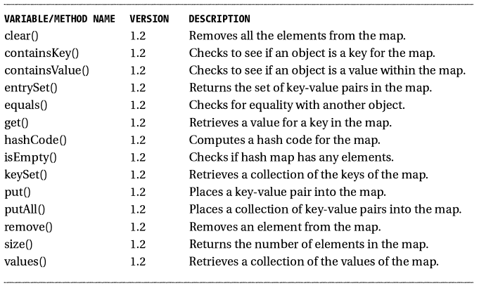
Methods of the Map Interface

Slide 59
Creating a new HashMap
HashMap() – creates a default HashMap
HashMap(int initialCapacity) – creates a HashMap with a specified initial capacity
HashMap(int intialCapacity, float loadFactor) – adds a parameter to tell system how full the Map should be before it adds more storage (.75 is the default)
Higher loadFactor values decrease the space overhead but increase the lookup cost (e.g., get and put).
The expected number of entries in the map and its load factor should be taken into account when setting its initial capacity, so as to minimize the number of rehash operations.
If the initial capacity is greater than the maximum number of entries divided by the load factor, no rehash operations will ever occur.
HashMap(Map map) – creates a default HashMap from another Map

Slide 60
Working with Elements in a HashMap
put(key, value);
remove(key);
get(key);

Slide 61
TreeMaps
Legend
interface
class

Slide 62
TreeMap
Like other maps, TreeMaps work on key-value pairs.
TreeMaps differ from HashMaps because the keys are sorted. They should be used only when order of the keys matters.
HashMaps use an array and a hashing function to store elements. When you try to insert or delete an item in the array the hashing function converts the key into an index on the array where the object is/should be stored (ignoring conflicts). While hashmaps are generally very fast because they don't need to iterate over large amounts of data, they slow down when they're filled because they need to copy all the key/values into a new array.
TreeMaps store a the data in a sorted tree structure. While this means that they'll never have to allocate more space and copy over to it, operations require that part of the data already stored be iterated over. Sometimes changing large amounts of the structure.
There are some extra methods associated with TreeMaps.

Slide 63
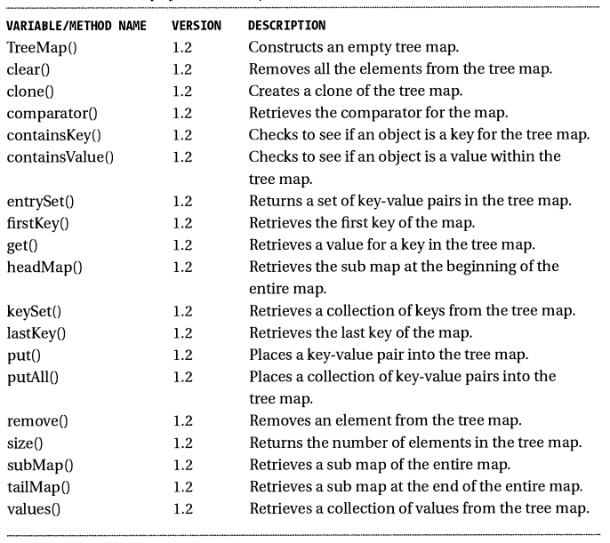

Slide 64
LinkedHashMap
There is also a LinkedHashMap which works like the LinkedList, but stores data in key value pairs
public class Word {
private int position; // holds the position of the word in the phrase
private String text; // holds the text of the word so far, i.e., * and determined letters
private String pattern; // lower case for the regexp, upper case for letters that are determined
private LinkedHashMap<String, Guess> guesses; // holds the computer's guesses for the word... ORDER is important.
private Boolean solved; // set to TRUE if computer believes the word is solved
Guess class has a the text of a String and an ArrayList of word sources

Slide 65
Other cool stuff

Slide 66
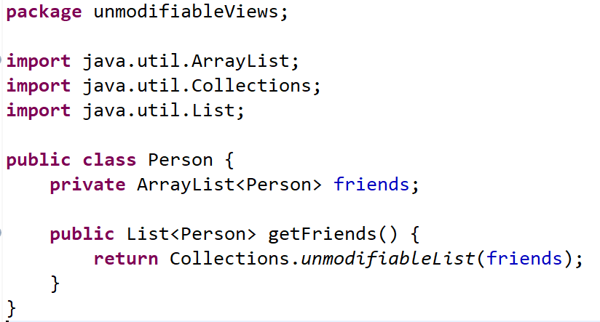
Unmodifiable Views
Sometimes, you want to share the contents of a collection but you don't want it to be modified.
You could copy the values into a new collection, but that is potentially expensive.; an unmodifiable view is a better choice.
Example: a Person object maintains a list of friends. If the getFriends gave out a reference to that list, a caller could mutate it. But it is safe to provide an unmodifiable list view:
If the getter returns friends, whoever gets that list could change it.
But you can return an unmodifiable view of friends.

Slide 67
.of() methods
The List, Set, and Map interfaces provide static methods yielding a set or list with given elements, and a map with given key/value pairs.
Map<String, Integer> unmodifiableMap = Map.of("Peter", 2, "Paul", 3, "Mary", 5);
Map<String, Integer> map =
new HashMap<String, Integer>(Map.of("Peter", 2, "Paul", 3, "Mary", 5));
List<String> unmodifiableList = List.of("Peter", "Paul", "Mary")
List<String> list =
new ArrayList<String>(List.of("Peter", "Paul", "Mary"));
Set<Integer> unmodifiableSet = Set.of(2, 3, 5);
Set<Integer> set = new Set<Integer>(Set.of(2, 3, 5));

Slide 68
Conclusion

Slide 69
Iterating over Collections
Type of Collection | Ways to Loop Thru Collection | Comments
Array | For loop with counter While loop with counter Enhanced for loop (for-each) Do-while loop with counter | Arrays & counters go hand-in-hand Arrays & counters go hand-in-hand OK BAD! Assumes there is 1 element
ArrayList | Enhanced for loop (for-each) .forEach() method Iterator (while iterator hasNext) For loop with counter While loop with counter Do-while loop with counter | A natural, if you don't need index position Also a natural. Can use parallel streams too Another great fit; needed if you remove items OK OK BAD! Assumes there is 1 element
HashMap | Enhanced for loop (values) Enhanced for loop (keys) Enhanced for loop (entries) .forEach() method for the above Value iterator (while hasNext) Key iterator (while hasNext) Entry iterator (while hasNext) | When you only need the values When you only need the keys When you need both keys and values (see above) When you only need the values; can remove! When you only need the keys; can remove! When you need key/values pairs; can remove!
HashSet | Enhanced for loop (for-each) .forEach method() Iterator (while iterator hasNext) | A natural, if you don't need index position Also a natural. Can use parallel streams too Another great fit; needed if you remove items

Slide 70
To Learn These Collections…
Don't over-rely on ArrayList!
Try to utilize other types of collections in your coding for this class when appropriate
There are other interesting collections in Java (see Chapter 7 of Horstmann)
A stack is a data structure for adding and removing elements at one end (the “top” of the stack).
A queue lets you efficiently add elements at one end (the “tail”) and remove them from the other end (the “head”).
A double-ended queue, or deque, supports insertion and removal at both ends. With all these data structures, adding elements in the middle is not supported.
A priority queue retrieves elements in sorted order after they were inserted in arbitrary order.
The WeakHashMap class was designed to solve an interesting problem. What happens with a value whose key is no longer used anywhere in your program? If the last reference to a key has gone away, there is no longer any way to refer to the value object so it should be removed by the garbage collector.

